Slide 1


DAY 3 OF CYBERSECURITY 101
OSINT AND DIGITAL FORENSICS
Understanding OSINT, DFIR, geolocation, metadata, forensics, OPSEC.

Slide 2
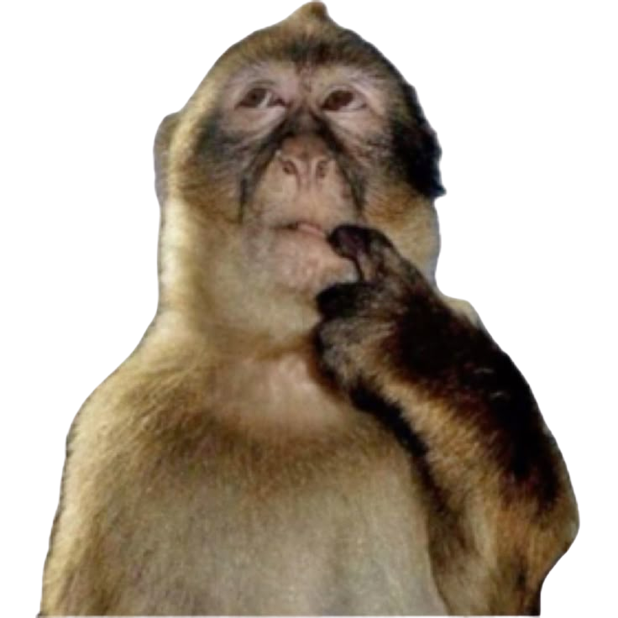
HOW MUCH CAN THE INTERNET REVEAL ABOUT YOU

Slide 3
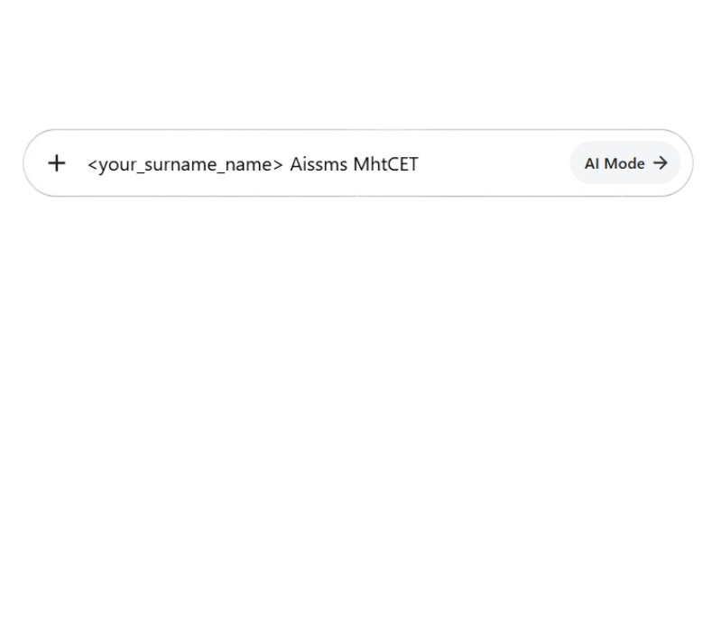

LET’S TEST IT. SEARCH THIS UP
For example : koul sushant aissms mhtcet

Slide 4



WHAT IS INTELLIGENCE?
Intelligence is information that has been collected, checked and analysed so that it helps someone make a decision.
Raw facts alone are not intelligence – they become intelligence only when someone understands what they mean and what to do about them.

Slide 5
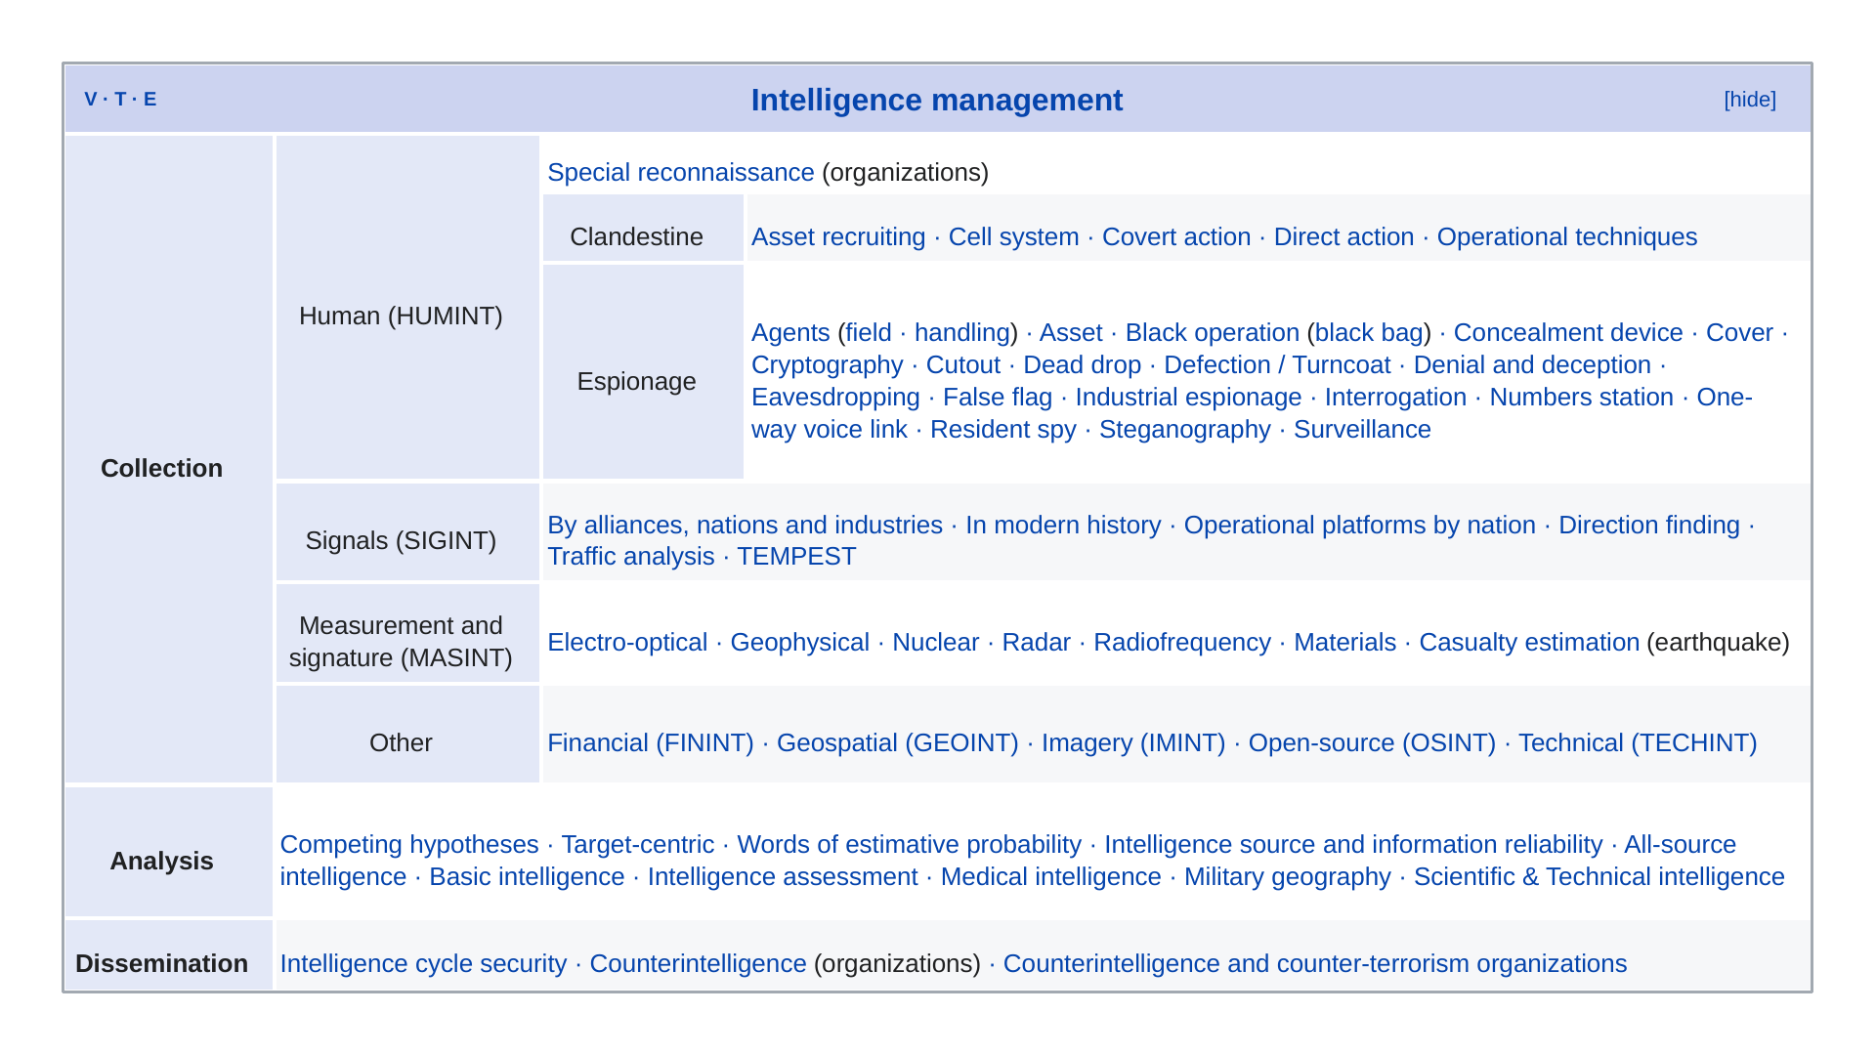

Slide 6
WHAT IS OSINT?
OSINT stands for Open Source Intelligence. It means collecting information that is freely and legally available to the public and turning it into something useful.
"Open source" here does not mean open-source software. It means open, public sources – anything anyone can see without hacking or breaking in.

Slide 7

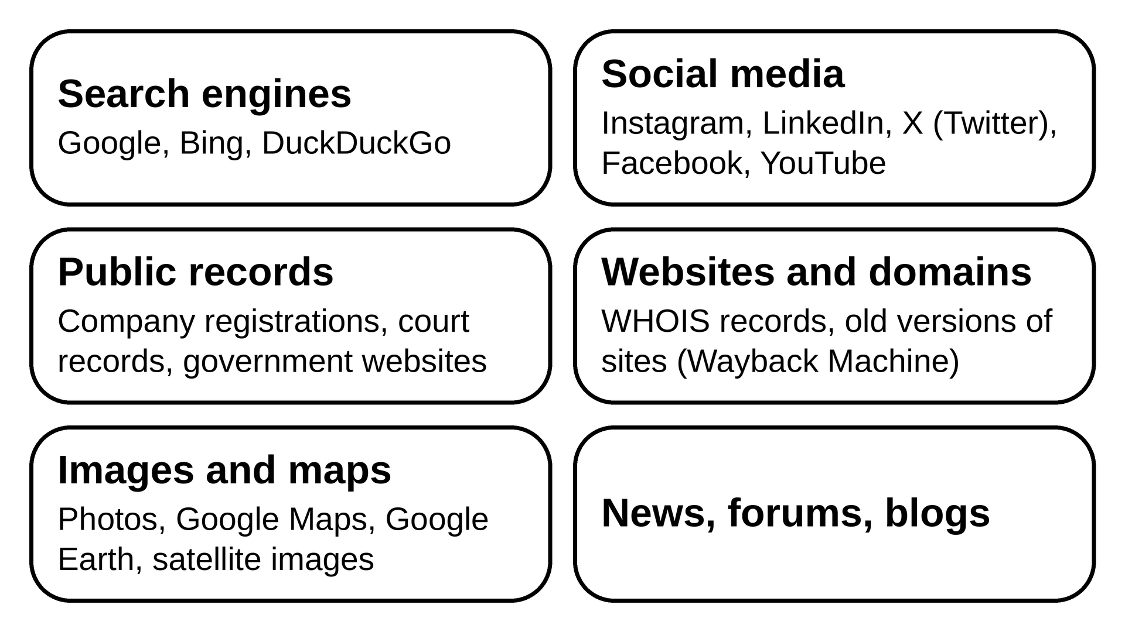
OPEN SOURCE

Slide 8

WHAT IS DIGITAL FORENSICS?
Simple example: A company's data is stolen. A forensic expert makes an exact copy of the employee's laptop, finds deleted files, checks browser history and USB logs, and proves the data was copied to a pen drive on a certain date.
Digital forensics means finding, collecting and studying evidence from digital devices – computers, phones, hard disks, USB drives, cloud accounts and networks – in a way that can be trusted in court.

Slide 9
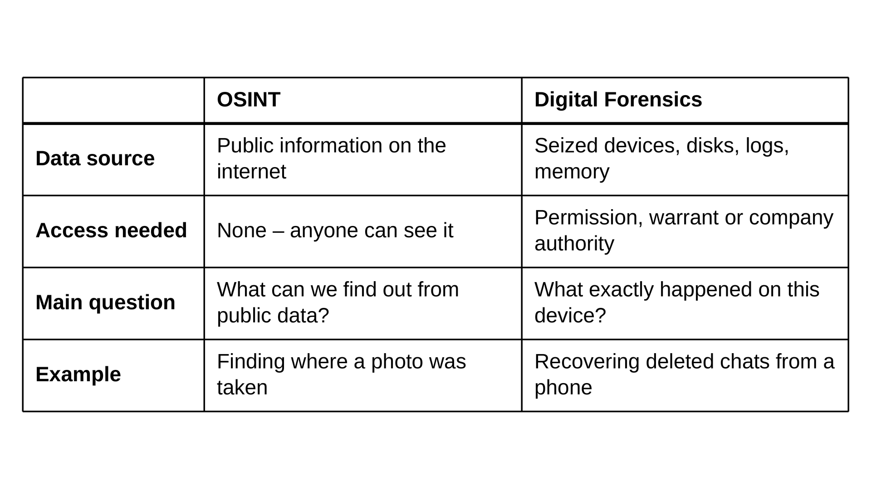
OSINT VS DIGITAL FORENSICS

Slide 10

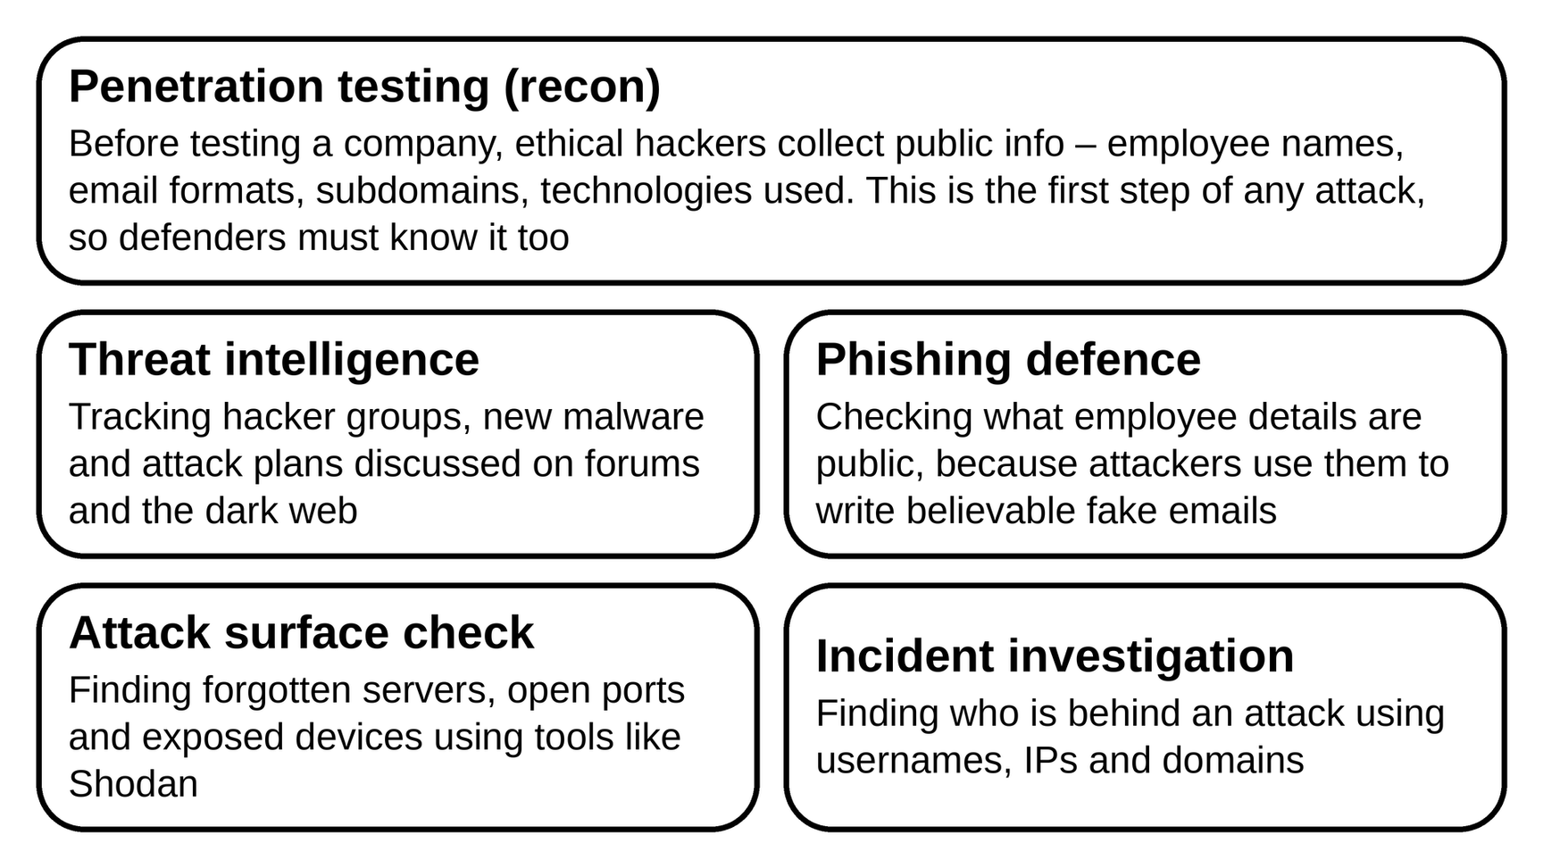
OSINT IN CYBER & IRL
CYBER-
IRL-
  Journalism
  Police and law enforcement
  Business
  Personal safety
  Human rights

Slide 11

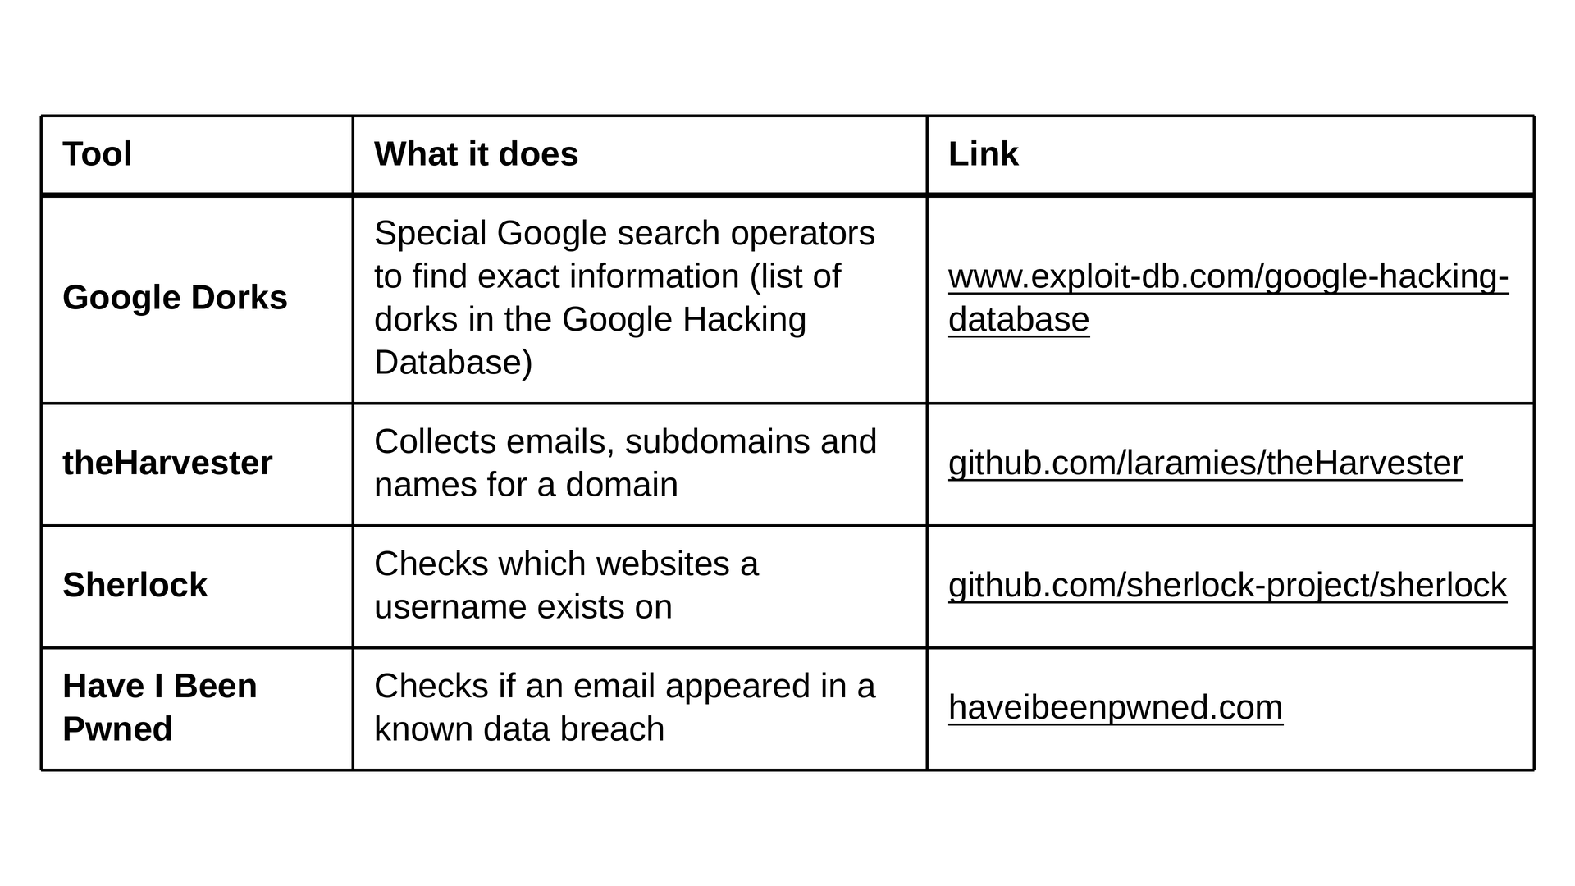
COMMON OSINT TOOLS

Slide 12
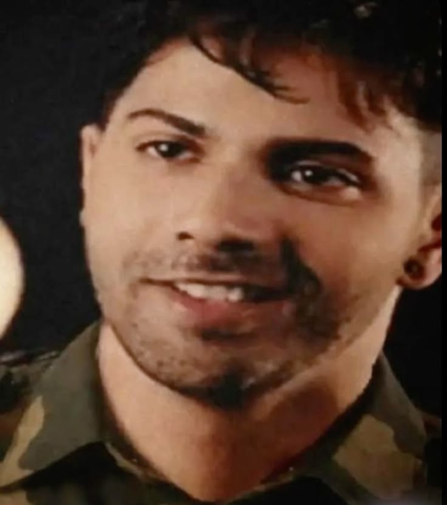
QUIZZ 1 :-
1. Is looking at someone's public Instagram profile OSINT?
2. When you delete a file, what usually stays on the disk?

Slide 13
ANSWERS
1. Yes, if you only look at public data
2. The data, until something overwrites it

Slide 14
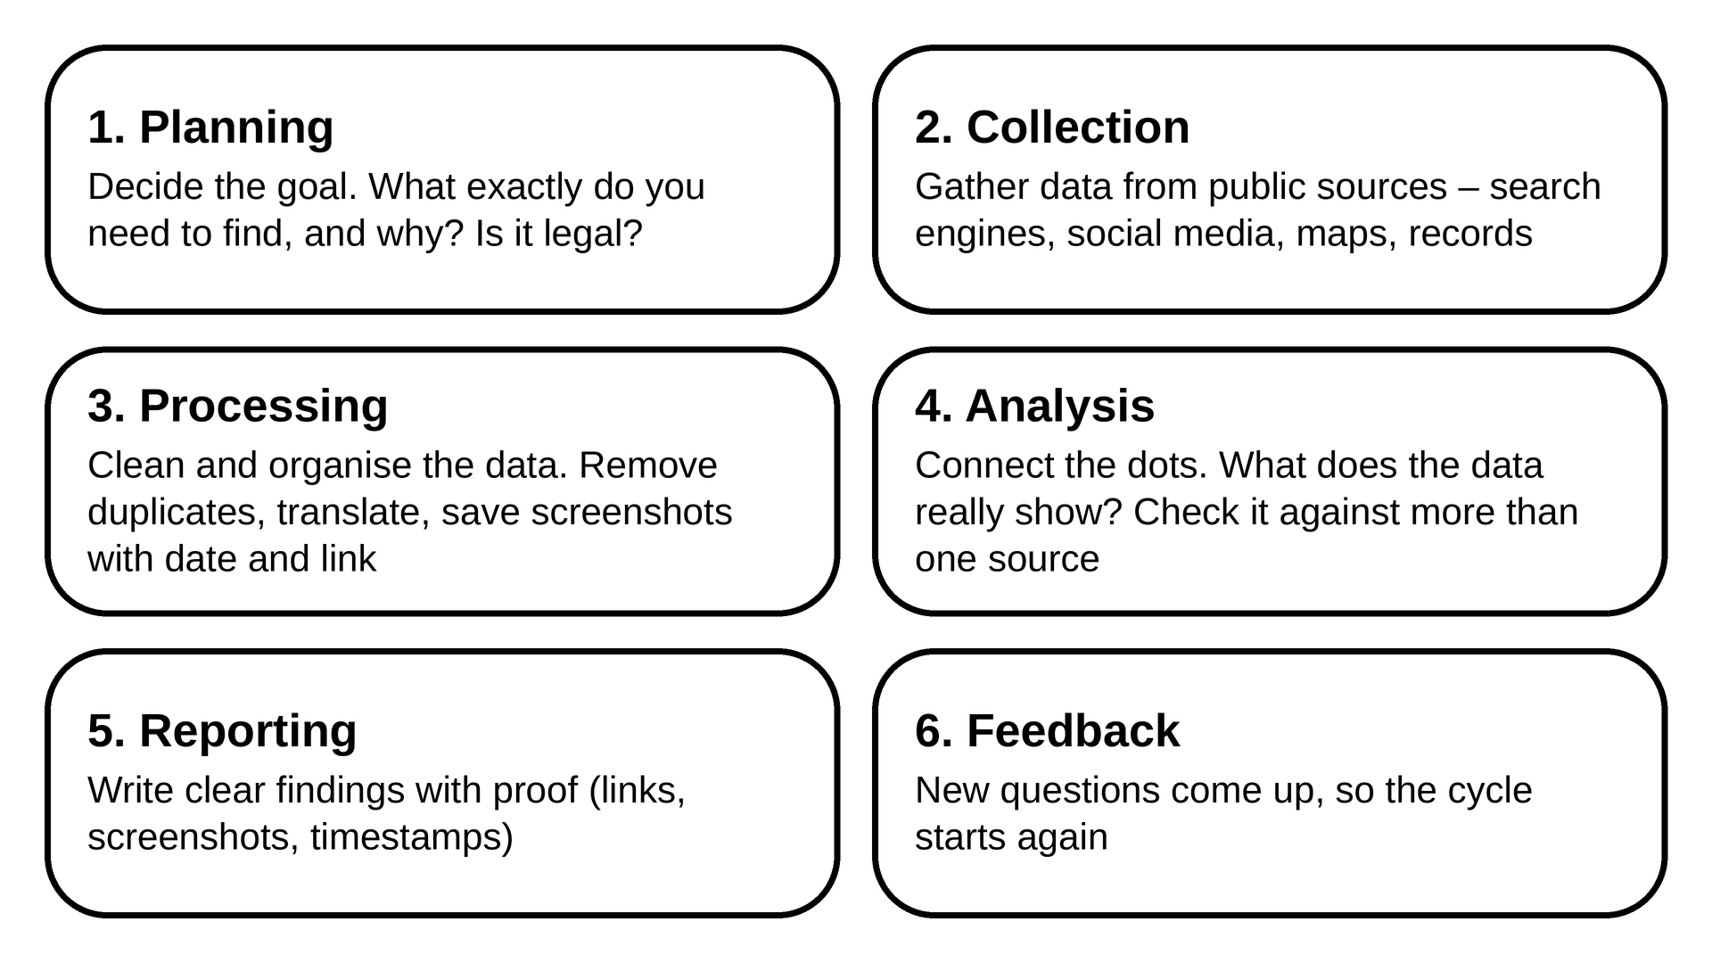
OSINT METHODOLOGY – THE INTELLIGENCE CYCLE

Slide 15



PASSIVE VS ACTIVE OSINT
 | Passive | Active
Meaning | Only look at public data, never touch the target | Interact with the target directly
Target knows? | No | May notice
Example | Reading someone's public LinkedIn, Google search | Port scanning their server, sending a friend request

Slide 16

INTRO TO DFIR
DFIR stands for Digital Forensics and Incident Response. It is what a company does when it gets hacked.
EXAMPLE >>>>> A THEIF BREAKS INTO A SHOP
• First, the police and guards rush in, catch or chase out the thief, lock the doors and make sure the shop can open again. That is Incident Response – act fast and stop the damage
• Then a detective comes in, carefully collects fingerprints and CCTV footage, and finds out how the thief got in, what was stolen and who did it. That is Digital Forensics – investigate and collect proof
In DFIR, the "shop" is a computer or network, the "thief" is a hacker, and the "fingerprints" are things like log files, deleted files and network traffic.

Slide 17

DFIR
• Incident Response (IR) – "Stop it!": act fast when an attack is happening – stop it, remove the hacker and get systems running again
• Digital Forensics (DF) – "What happened?": investigate carefully – how the hacker got in, what they did, what they took, and collect evidence
Real example: a company's computers suddenly show a ransomware message. The IR team unplugs the infected PCs from the network so it cannot spread, and restores files from backups. The forensics team then finds the phishing email that started it, sees which files were stolen, and writes a report for the police and management.

Slide 18
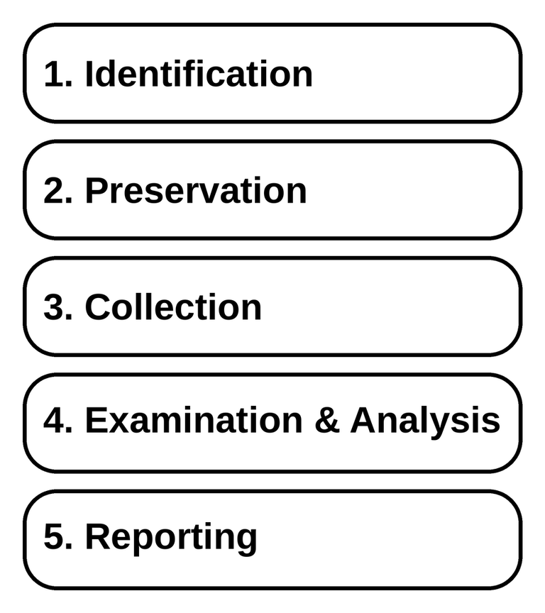
METHODOLOGY
Tool | Used for
Autopsy | Free tool to examine disk images, find deleted files and build timelines
FTK Imager | Makes exact forensic copies (images) of drives
Volatility | Analyses RAM (memory) dumps
Wireshark | Analyses network traffic captures
ExifTool | Reads file and photo metadata

Slide 19
QUIZZ 2: PICK THE ANSWER
Finding the phishing email that started a ransomware attack is:
A) Incident Response
B) Forensics
C) Passive OSINT

Slide 20
QUIZZ 2: PICK THE ANSWER
Finding the phishing email that started a ransomware attack is:
A) Incident Response
B) Forensics
C) Passive OSINT
B) Forensics
ANSWER

Slide 21
REVERSE IMAGE SEARCH
Normally you type words to find images. Reverse image search works the other way: you upload a picture and it finds where else that picture (or similar ones) appears online.
Uses:
• Find the original source and first date of a photo
• Catch fake news – an "earthquake today" photo that is actually 5 years old
• Catch fake profiles – a dating or scam profile using someone else's photos
• Identify a place, building, product or landmark in a photo

Slide 22
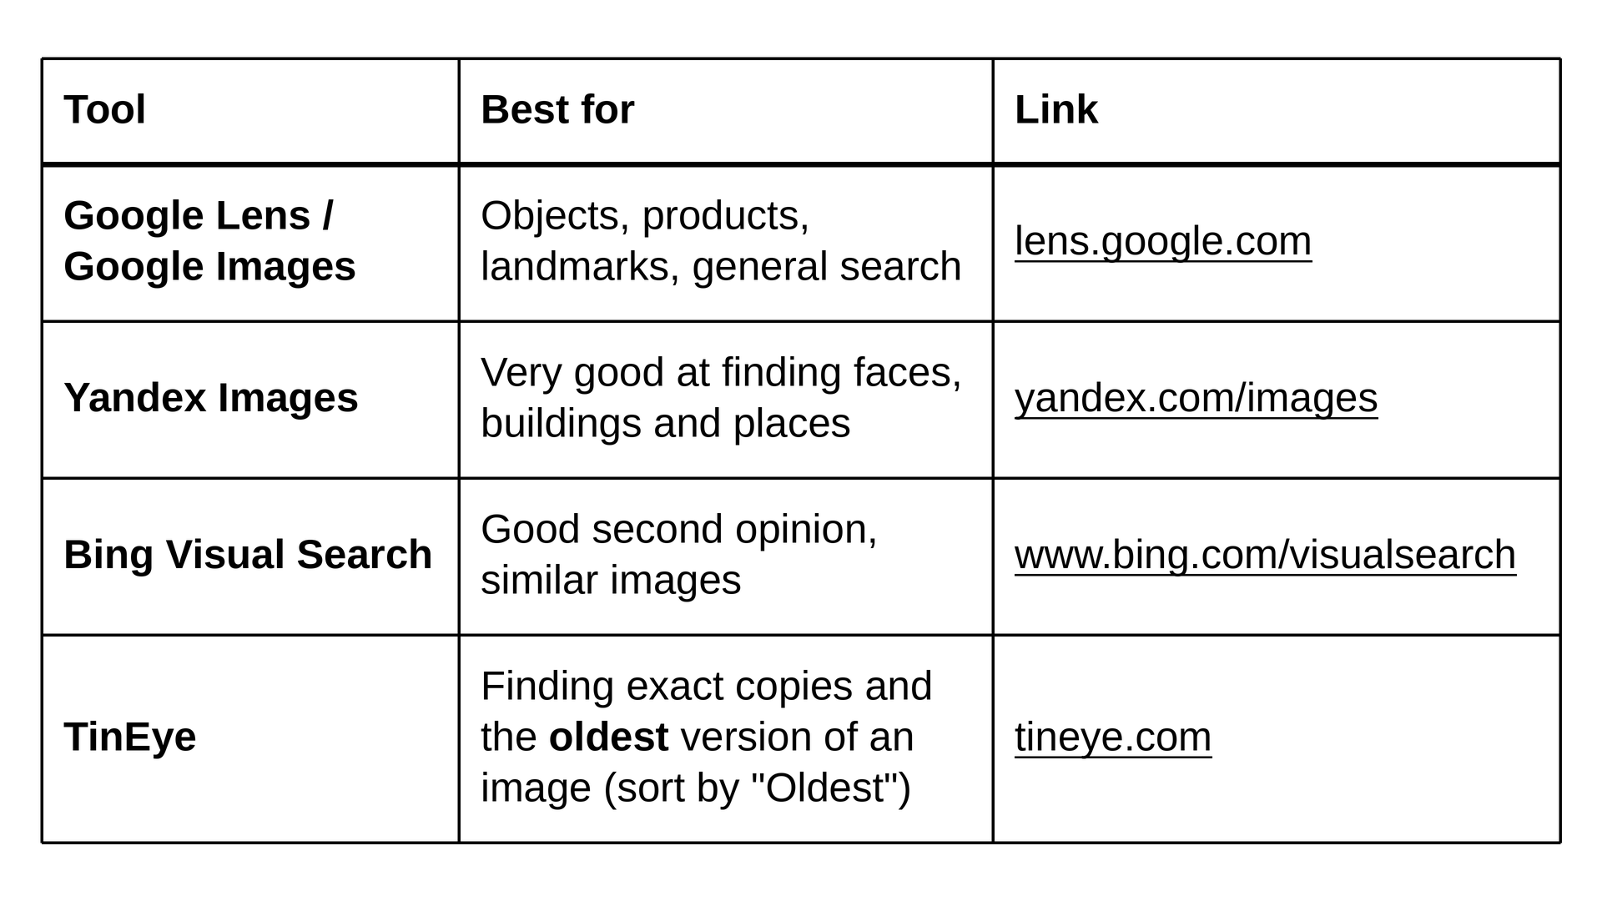
REVERSE IMAGE SEARCH TOOLS

Slide 23
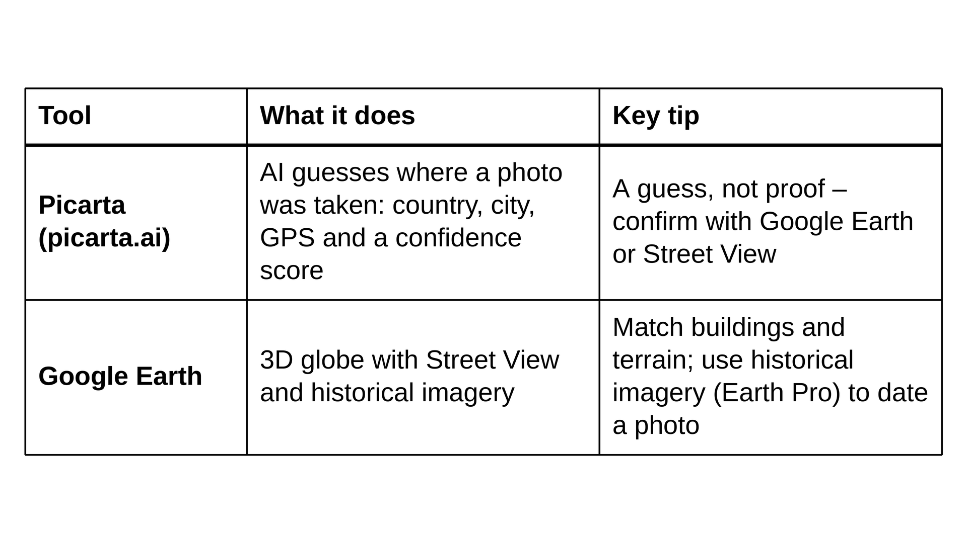
REVERSE IMAGE SEARCH ADVANCED TOOLS

Slide 24

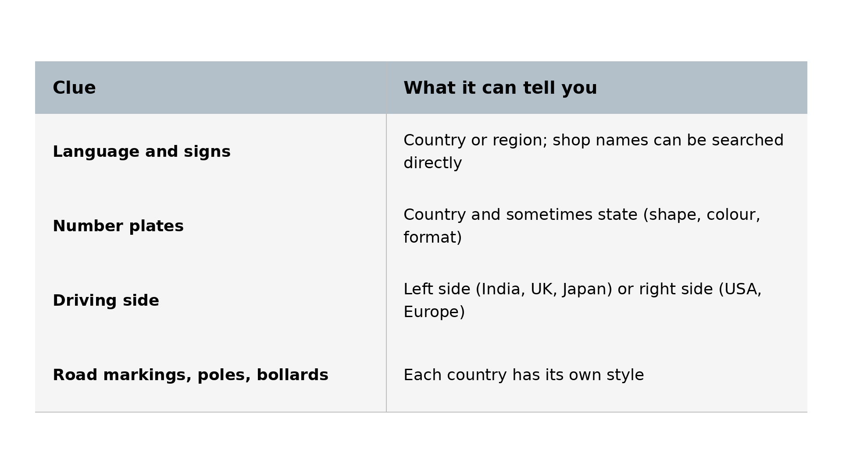
GEOSINT
GEOSINT (Geospatial OSINT) means finding the exact place where a photo or video was taken, using only clues visible in it.

Slide 25
METHODOLOGY
1. Check the metadata first – the photo may already have GPS
2. Run a reverse image search – the photo may already be online with a location
3. Write down every clue in the image
4. Narrow down: continent → country → city → street
5. Use Google Maps, Street View and Google Earth to find the exact spot
6. Confirm by matching at least 2–3 features (a building + a pole + a mountain in the back)
Practice: the game GeoGuessr trains exactly this skill.
Safety lesson: this is why you should be careful posting photos from your home, school or with your house number visible.

Slide 26

EXAMPLE :
WHAT DOES IT SAY HERE :
51.48449044020304, 0.08799148642372842

Slide 27

HINT :
USE GOOGLE EARTH

Slide 28
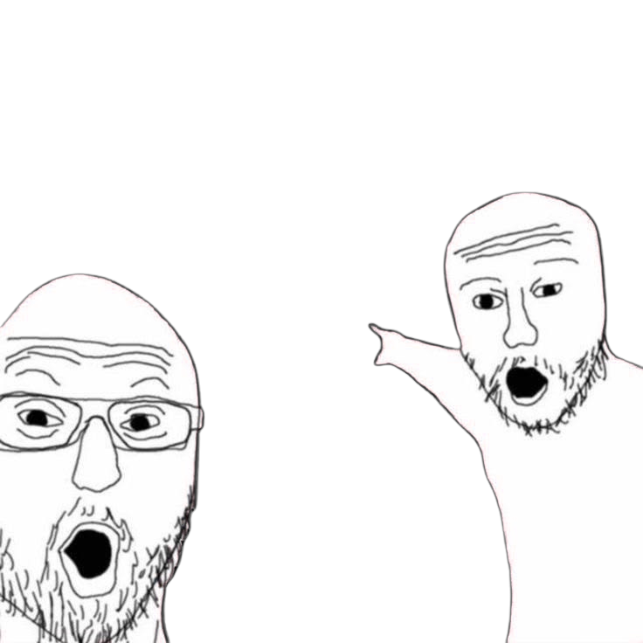
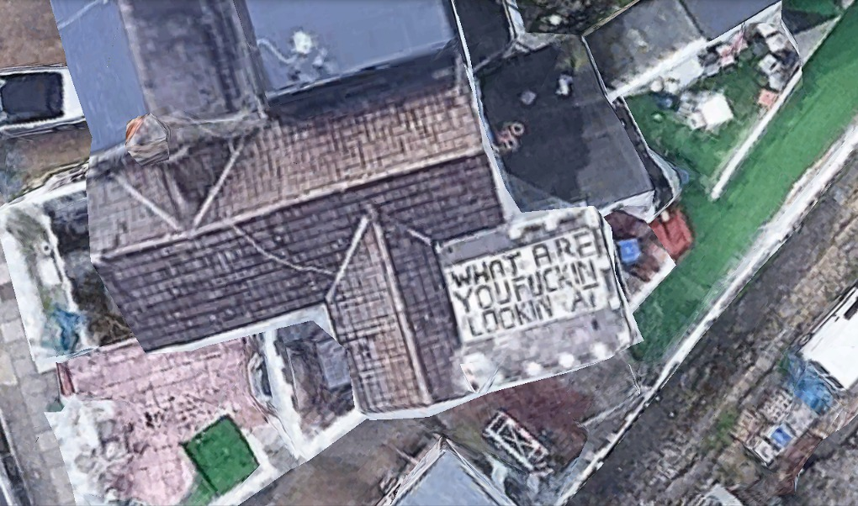
ANSWER :
CENSOR-

Slide 29
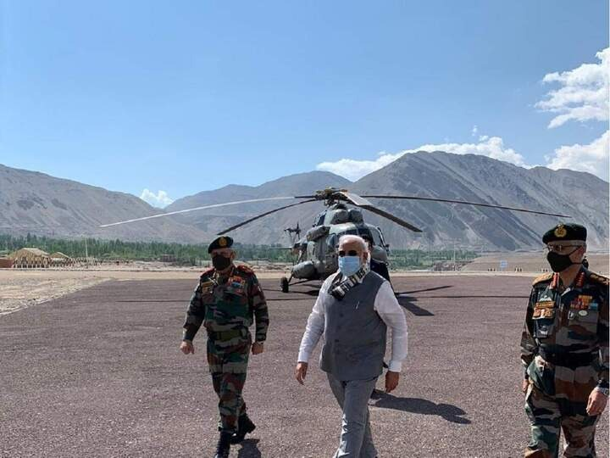
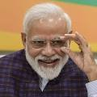
Ground Truth Verification or Street-Level Signage Analysis
TAKE HOME PROBLEM :
WATCH THE SOLUTION :
YOUTUBE

Slide 30
DIGITAL FORENSICS
Digital forensics is like detective work for computers and phones. Every action on a device leaves small traces – opening a file, visiting a website, plugging in a USB, sending a message. A forensic investigator finds these traces and uses them to tell the story of what happened, when, and who did it.
Simple rule: in digital forensics, nothing is ever fully gone. Even deleted files, cleared history and wiped chats often leave traces behind.

Slide 31
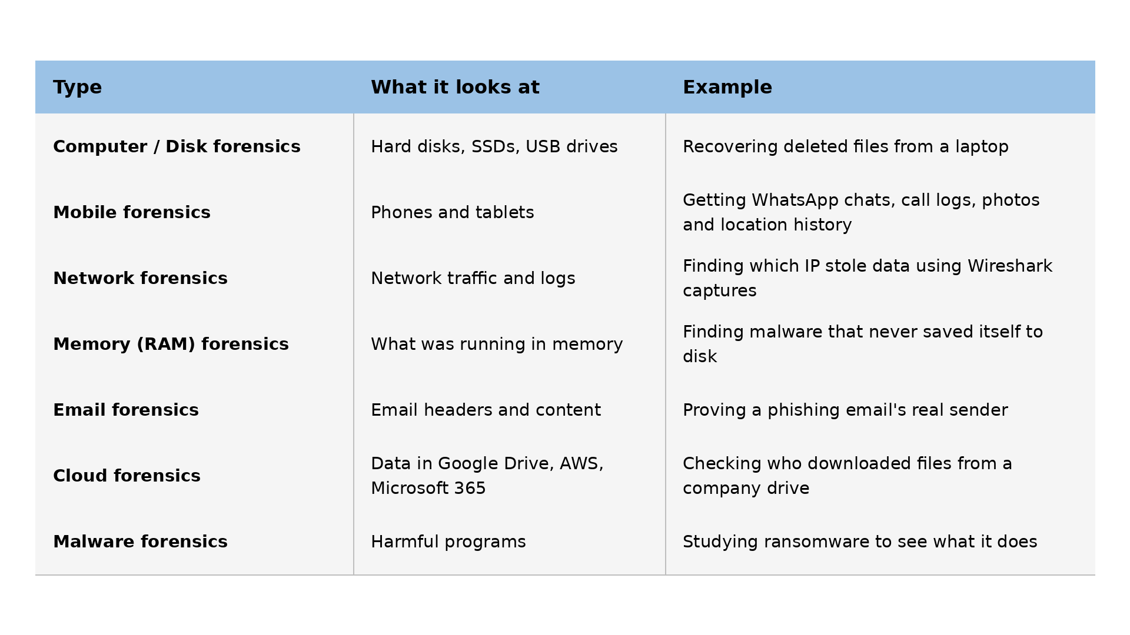
DIGITAL FORENSICS

Slide 32

WHAT EVIDENCE CAN BE FOUND?
• Deleted files: when you delete a file, usually only its "address" is removed – the data stays on the disk until something overwrites it
• Browser history, downloads and cookies: which websites were visited and when
• Log files: logins, errors, system events – like a diary the computer keeps
• USB history: which pen drives were plugged in and when
• Recently opened files and programs: Windows keeps lists of these (e.g. in the Registry and Prefetch)
• Storage: Chats, emails, call logs and photos on phones
• Metadata: hidden details inside files

Slide 33
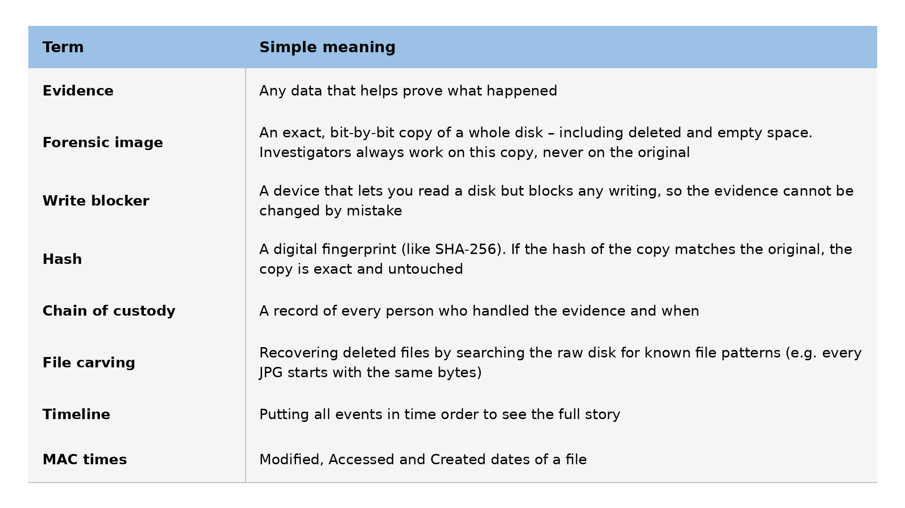
IMPORTANT TERMINOLOGIES FOR BEGINNERS

Slide 34

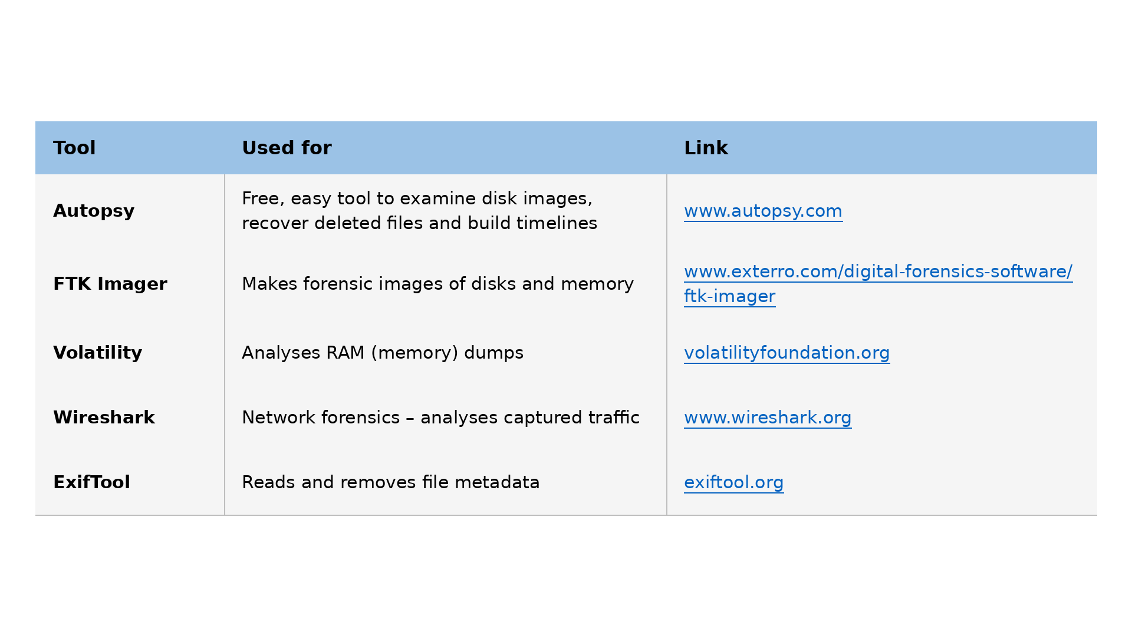
POPULAR FORENSIC TOOLS

Slide 35

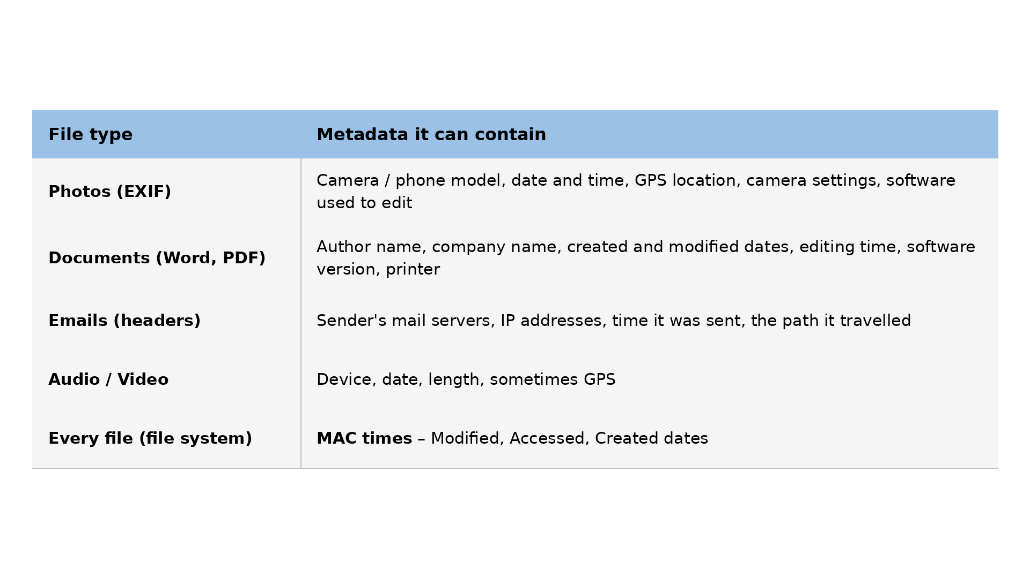
METADATA AND ITS IMPORTANCE
Metadata is "data about data". It is hidden information stored inside a file that describes the file itself.
Simple example: a photo shows a beach. That is the data. But hidden inside the file is: which phone took it, the exact date and time, and the GPS location. That is the metadata.

Slide 36

WHY METADATA IS IMPORTANT
• Forensic evidence: proves when a file was created or changed and on which device – helps build a timeline of events
• Catching fakes: a photo claimed to be "taken today" but its metadata says 2019, or it shows Photoshop was used
• Finding location: GPS in a photo shows exactly where it was taken
• OSINT recon: documents on a company website can leak employee names, usernames and software versions that attackers can target
• Privacy risk: you may share your home location just by sending a photo

Slide 37

REAL CASES
Case 1: BTK Killer (USA, 2005)
• Who: Dennis Rader, a serial killer who murdered 10 people in Wichita, Kansas between 1974 and 1991. He named himself "BTK" and was not caught for about 30 years
• His mistake: in 2004 he started sending letters to police and the media again. He asked police if a floppy disk could be traced – they said no
• The clue: in 2005 he sent a floppy disk to a TV station. Investigators found a deleted Word file on it. Its metadata showed the organisation "Christ Lutheran Church" and the user "Dennis"
• The result: a quick internet search showed Dennis Rader was the church council president. DNA confirmed it, he was arrested in February 2005 and got 10 life sentences
• Lesson: deleted does not mean gone, and documents carry hidden author details

Slide 38
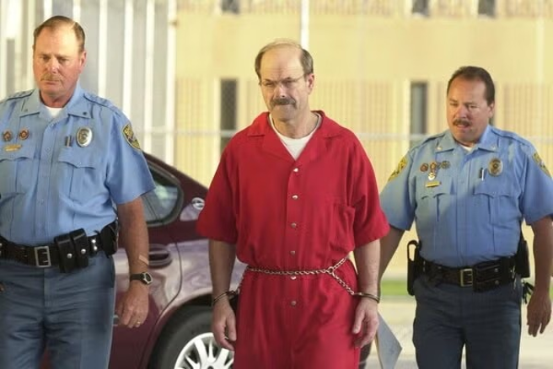

Slide 39
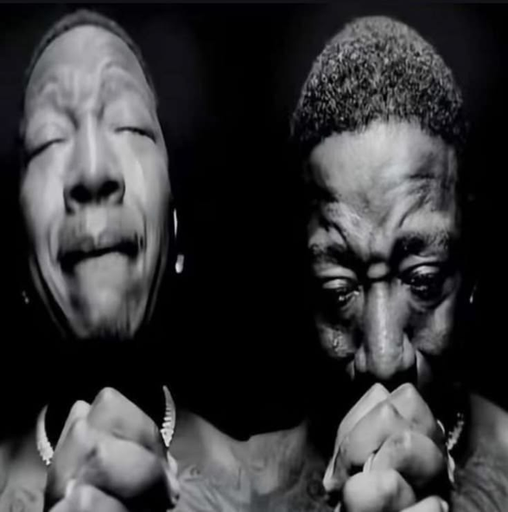
REAL CASES
Case 2: John McAfee (2012)
• Who: John McAfee, founder of the McAfee antivirus company
• What happened: in November 2012, police in Belize wanted to question him about his neighbour's death. He went into hiding and kept posting online about being on the run
• The clue: journalists from Vice magazine travelled with him and posted a photo of him taken on an iPhone. They forgot to remove the EXIF metadata – the GPS coordinates showed he was in Guatemala
• The result: his location became public within hours, and he was arrested in Guatemala a few days later for entering the country illegally
• Lesson: always remove metadata before posting photos online

Slide 40
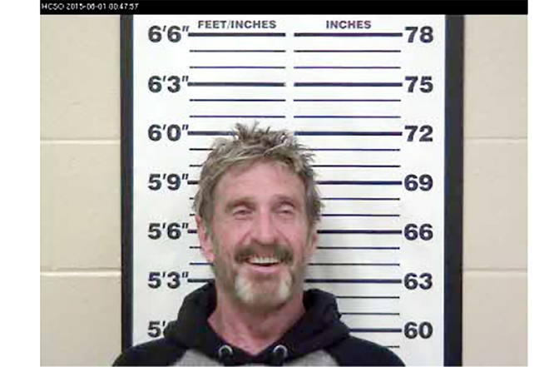

Slide 41
QUIZ 3: ANSWER IT YOURSELF
What should you do to a photo before posting it online?

Slide 42
EXIFTOOL
EXIF (Exchangeable Image File Format) is the standard for the metadata that cameras and phones save inside photos.
ExifTool is a free command-line tool that can read, edit and remove metadata from almost any file – photos, videos, PDFs, Word files and more.
SETUP(In your codespaces)
cd challenges/Protocol_Day_3
sh setup_day3.sh
Repo: github.com/omsapate23/protocol-cybersecurity-101-bootcamp

Slide 43
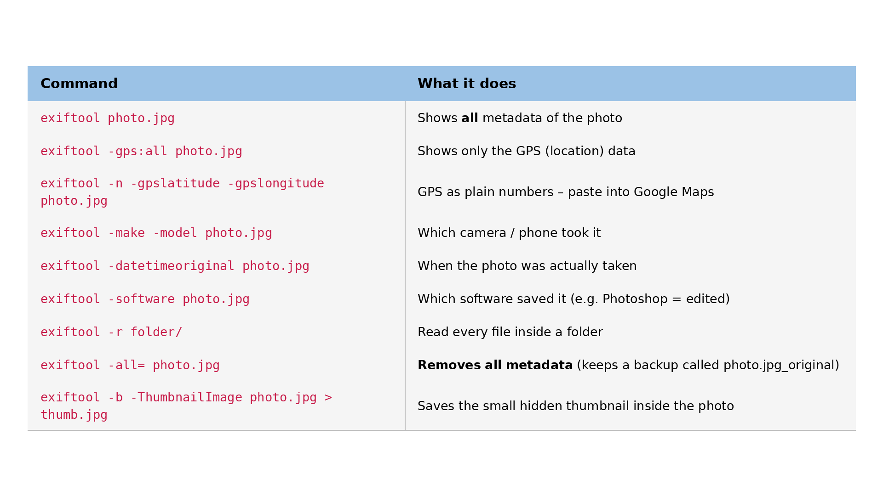
USEFUL COMMANDS

Slide 44
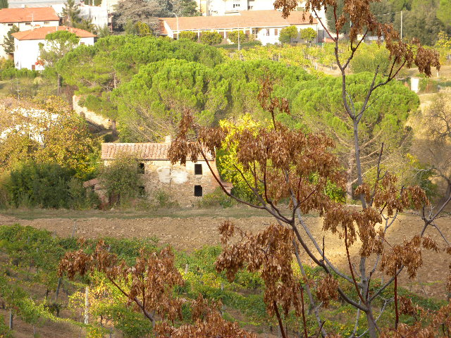
LEVEL 1: WHERE WAS THIS TAKEN?
Go to Challenges; then Protocol_Day_3 on your codespace
File: tuscany_photo.jpg
exiftool tuscany_photo.jpg
exiftool -make -model tuscany_photo.jpg
exiftool -gpslatitude -gpslongitude -n tuscany_photo.jpg

Slide 45
QUESTIONS
1. Which camera took it?
2. Which country is it?

Slide 46
Image forensics means checking if a photo is real, edited or fake, and finding hidden information inside it.
IMAGE FORENSICS
What to check:
1. Metadata: date, device, GPS and Software field. Missing metadata can also be a clue (it was removed or the image was re-saved)
2. Thumbnail mismatch: the hidden thumbnail inside the photo may still show the original image before it was edited
3. Error Level Analysis (ELA): re-saves the image and shows which parts compress differently. Pasted or edited areas often glow brighter than the rest
4. Clone detection: finds parts of the image that were copied and pasted (e.g. extra smoke or crowds)
5. Light and shadows: shadows pointing in different directions mean objects were added
6. Reverse image search: find the original, unedited version online
7. Hidden data: files hidden inside the image (binwalk) or secret messages (steganography tools like steghide)

Slide 47


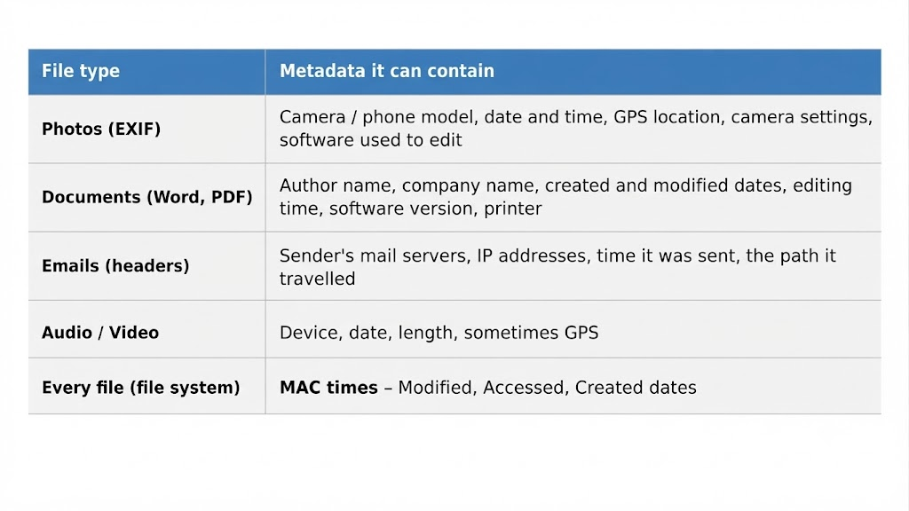
IMAGE FORENSICS

Slide 48
LEVEL 2: SOMETHING IS HIDDEN.
GO TO YOUR CODESPACE CHALLENGES AND THEN TO Protocol_Day_3
File: hidden_photo.jpg
COMMANDS:
exiftool hidden_photo.jpg
binwalk hidden_photo.jpg
binwalk -e hidden_photo.jpg
cat _hidden_photo.jpg.extracted/flag.txt

Slide 49
QUESTIONS
1. What does binwalk find after the JPEG?
2. What is the flag?

Slide 50

AUDIO FORENSICS
Audio forensics means studying sound recordings to find the truth – whether a recording is real or edited, who is speaking, what is being said, and when or where it was recorded.
Simple example: someone gives the police a voice recording as proof. An audio forensic expert checks if any words were cut, added or joined, cleans up the noise so the speech is clear, and checks if the voice really belongs to the person.
Where It Is Used
• Court cases: proving a recording is original and not edited
• Fake voice (deepfake) detection: AI can now copy anyone's voice, so experts check if a voice is real
• Enhancement: making unclear speech easier to hear (removing hiss, traffic, wind)
• Speaker identification: comparing a voice with known samples of a person
• CTF challenges: hidden messages are often hidden inside audio files

Slide 51
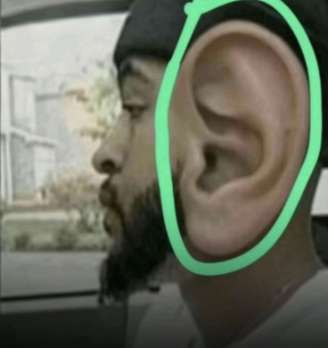
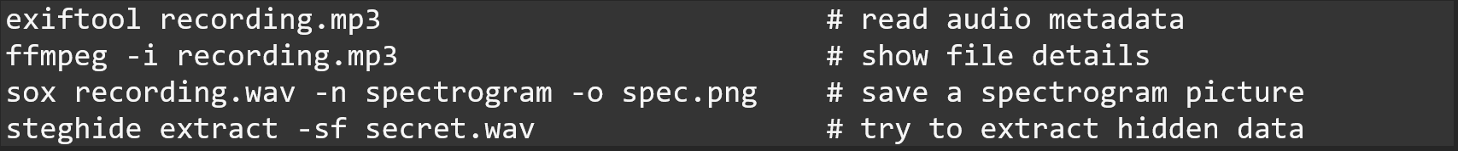
AUDIO FORENSICS
Hidden Data in Audio (CTF)
• Spectrogram images: text or pictures drawn into the sound that only appear in the spectrogram view
• Morse code: beeps of short and long sounds
• DTMF tones: phone keypad tones that can be decoded into numbers
• Steganography: secret files hidden inside WAV files (tools: steghide, DeepSound)
• Reversed or slowed audio: play it backwards or at a different speed
Useful Commands :

Slide 52
LEVEL 3: SEE THE SOUND.
GO TO YOUR CODESPACE CHALLENGES AND THEN TO PROTOCOL_DAY_3
File: secret_spectrogram.wav
COMMANDS:
sox secret_spectrogram.wav -n spectrogram -o spec.png
Open spec.png

Slide 53
QUESTIONS
1. What flag appears in the picture?

Slide 54

OPSEC (OPERATIONS SECURITY)
OPSEC means protecting your own information so that others cannot use it against you. OSINT is about finding information on others – OPSEC is about not leaking information about yourself.
The idea came from the US military during the Vietnam War, when the enemy kept learning about attacks in advance – not from spies, but from small public details that added up.
Simple example: you post "Flying to Goa for a week!" with a photo of your boarding pass. Now strangers know your house is empty, and the barcode on the pass can reveal your booking details. That is bad OPSEC.

Slide 55
OPSEC (OPERATIONS SECURITY)
The 5 Steps of OPSEC:
1. Identify critical information: what must stay secret? (home address, passwords, travel plans, company projects)
2. Analyse threats: who might want it? (hackers, stalkers, scammers, competitors)
3. Analyse vulnerabilities: how could they get it? (social media posts, photo metadata, weak passwords)
4. Assess the risk: how likely is it, and how bad would it be?
5. Apply countermeasures: fix it – change settings, remove posts, use better tools

Slide 56
OPSEC (OPERATIONS SECURITY)
Real Example: Strava Heatmap (2017–2018)
The fitness app Strava published a global map showing where its users went running.
Soldiers using fitness trackers at secret military bases had their running routes on the map – so the locations and layouts of military bases became visible to anyone.
No hacking was needed. It is a famous lesson that even harmless data can break OPSEC.

Slide 57

THANK YOU
JOIN OUR COMMUNITY

Slide 58
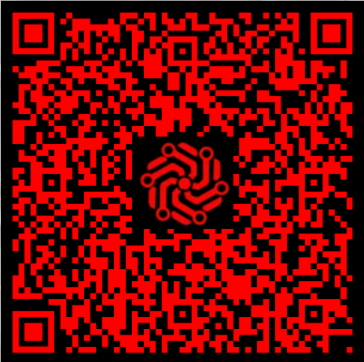
JOIN
THE
CTF

